Slide 1


Chapter 10
Extending the Limits of Tractability
Slides by Kevin Wayne.
Copyright @ 2005 Pearson-Addison Wesley.
All rights reserved.

Slide 2
Coping With NP-Completeness
Q. Suppose I need to solve an NP-complete problem. What should I do?
A. Theory says you're unlikely to find poly-time algorithm.
Must sacrifice one of three desired features.
  Solve problem to optimality.
  Solve problem in polynomial time.
  Solve arbitrary instances of the problem.
This lecture. Solve some special cases of NP-complete problems that arise in practice.

Slide 3
10.1 Finding Small Vertex Covers

Slide 4
Vertex Cover
VERTEX COVER: Given a graph G = (V, E) and an integer k, is there a subset of vertices S ⊆ V such that |S| ≤ k, and for each edge (u, v) either u ∈ S, or v ∈ S, or both.
1
6
2
7
k = 4
S = { 3, 6, 7, 10 }
3
8
4
9
5
10

Slide 5
Finding Small Vertex Covers
Q. What if k is small?
Brute force. O(k n^{k+1}).
  Try all C(n, k) = O(n^{k}) subsets of size k.
  Takes O(k n) time to check whether a subset is a vertex cover.
Goal. Limit exponential dependency on k, e.g., to O(2^{k} k n).
Ex. n = 1,000, k = 10.
Brute. k n^{k+1} = 10³⁴ ⇒ infeasible.
Better. 2^{k} k n = 10⁷ ⇒ feasible.
Remark. If k is a constant, algorithm is poly-time; if k is a small constant, then it's also practical.

Slide 6
Finding Small Vertex Covers
Claim. Let u-v be an edge of G. G has a vertex cover of size ≤ k iff
at least one of G − { u } and G − { v } has a vertex cover of size ≤ k-1.
Pf. ⇒
  Suppose G has a vertex cover S of size ≤ k.
  S contains either u or v (or both). Assume it contains u.
  S − { u } is a vertex cover of G − { u }.
Pf. ⇐
  Suppose S is a vertex cover of G − { u } of size ≤ k-1.
  Then S ∪ { u } is a vertex cover of G. ▪
Claim. If G has a vertex cover of size k, it has ≤ k(n-1) edges.
Pf. Each vertex covers at most n-1 edges. ▪
delete v and all incident edges

Slide 7
Finding Small Vertex Covers: Algorithm
Claim. The following algorithm determines if G has a vertex cover of size ≤ k in O(2^{k} kn) time.
Pf.
  Correctness follows from previous two claims.
  There are ≤ 2^{k+1} nodes in the recursion tree; each invocation takes O(kn) time. ▪
boolean Vertex-Cover(G, k) {
if (G contains no edges) return true
if (G contains ≥ kn edges) return false
let (u, v) be any edge of G
a = Vertex-Cover(G - {u}, k-1)
b = Vertex-Cover(G - {v}, k-1)
return a or b
}

Slide 8

Finding Small Vertex Covers: Recursion Tree
k
k-1
k-1
k-2
k-2
k-2
k-2
k - i
0
0
0
0
0
0
0
0

Slide 9
10.2 Solving NP-Hard Problems on Trees

Slide 10
Independent Set on Trees
Independent set on trees. Given a tree, find a maximum cardinality subset of nodes such that no two share an edge.
Fact. A tree on at least two nodes has
at least two leaf nodes.
Key observation. If v is a leaf, there exists
a maximum size independent set containing v.
Pf. (exchange argument)
  Consider a max cardinality independent set S.
  If v ∈ S, we're done.
  If u ∉ S and v ∉ S, then S ∪ { v } is independent ⇒ S not maximum.
  IF u ∈ S and v ∉ S, then S ∪ { v } − { u } is independent. ▪
degree = 1
u
v

Slide 11
Independent Set on Trees: Greedy Algorithm
Theorem. The following greedy algorithm finds a maximum cardinality independent set in forests (and hence trees).
Pf. Correctness follows from the previous key observation. ▪
Remark. Can implement in O(n) time by considering nodes in postorder.
Independent-Set-In-A-Forest(F) {
S ← φ
while (F has at least one edge) {
Let e = (u, v) be an edge such that v is a leaf
Add v to S
Delete from F nodes u and v, and all edges
incident to them.
}
return S
}

Slide 12
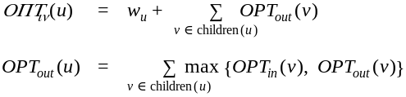
Weighted Independent Set on Trees
Weighted independent set on trees. Given a tree and node weights w_{v} > 0, find an independent set S that maximizes Σ_{v∈S} w_{v}.
Observation. If (u, v) is an edge such that v is a leaf node, then either OPT includes u, or it includes all leaf nodes incident to u.
Dynamic programming solution. Root tree at some node, say r.
  OPT_{in} (u) = max weight independent set
  of subtree rooted at u, containing u.
  OPT_{out}(u) = max weight independent set
  of subtree rooted at u, not containing u.
r
u
v
w
x
children(u) = { v, w, x }

Slide 13
Weighted Independent Set on Trees: Dynamic Programming Algorithm
Theorem. The dynamic programming algorithm finds a maximum weighted independent set in a tree in O(n) time.
Pf. Takes O(n) time since we visit nodes in postorder and examine each edge exactly once. ▪
Weighted-Independent-Set-In-A-Tree(T) {
Root the tree at a node r
foreach (node u of T in postorder) {
if (u is a leaf) {
M_{in} [u] = w_{u}
M_{out}[u] = 0
}
else {
M_{in} [u] = w_{u} + Σ_{v∈children(u)} M_{out}[v]
M_{out}[u] = Σ_{v∈children(u)} max(M_{in}[v], M_{out}[v])
}
}
return max(M_{in}[r], M_{out}[r])
}
ensures a node is visited after
all its children
can also find independent set itself (not just value)

Slide 14
Context
Independent set on trees. This structured special case is tractable because we can find a node that breaks the communication among the
subproblems in different subtrees.
Graphs of bounded tree width. Elegant generalization of trees that:
  Captures a rich class of graphs that arise in practice.
  Enables decomposition into independent pieces.
u
u
see Chapter 10.4, but proceed with caution

Slide 15
10.3 Circular Arc Coloring

Slide 16
Wavelength-Division Multiplexing
Wavelength-division multiplexing (WDM). Allows m communication streams (arcs) to share a portion of a fiber optic cable, provided they are transmitted using different wavelengths.
Ring topology. Special case is when network is a cycle on n nodes.
Bad news. NP-complete, even on rings.
Brute force. Can determine if
k colors suffice in O(k^{m}) time by
trying all k-colorings.
Goal. O(f(k)) ⋅ poly(m, n) on rings.
c
b
1
a
4
2
e
f
d
3
n = 4, m = 6

Slide 17
Wavelength-Division Multiplexing
Wavelength-division multiplexing (WDM). Allows m communication streams (arcs) to share a portion of a fiber optic cable, provided they are transmitted using different wavelengths.
Ring topology. Special case is when network is a cycle on n nodes.
Bad news. NP-complete, even on rings.
Brute force. Can determine if
k colors suffice in O(k^{m}) time by
trying all k-colorings.
Goal. O(f(k)) ⋅ poly(m, n) on rings.
c
b
1
a
4
2
e
f
d
3
n = 4, m = 6

Slide 18
Review: Interval Coloring
Interval coloring. Greedy algorithm finds coloring such that number of colors equals depth of schedule.
Circular arc coloring.
  Weak duality: number of colors ≥ depth.
  Strong duality does not hold.
maximum number of streams at one location
c
d
f
j
b
g
i
a
e
h
max depth = 2
min colors = 3

Slide 19
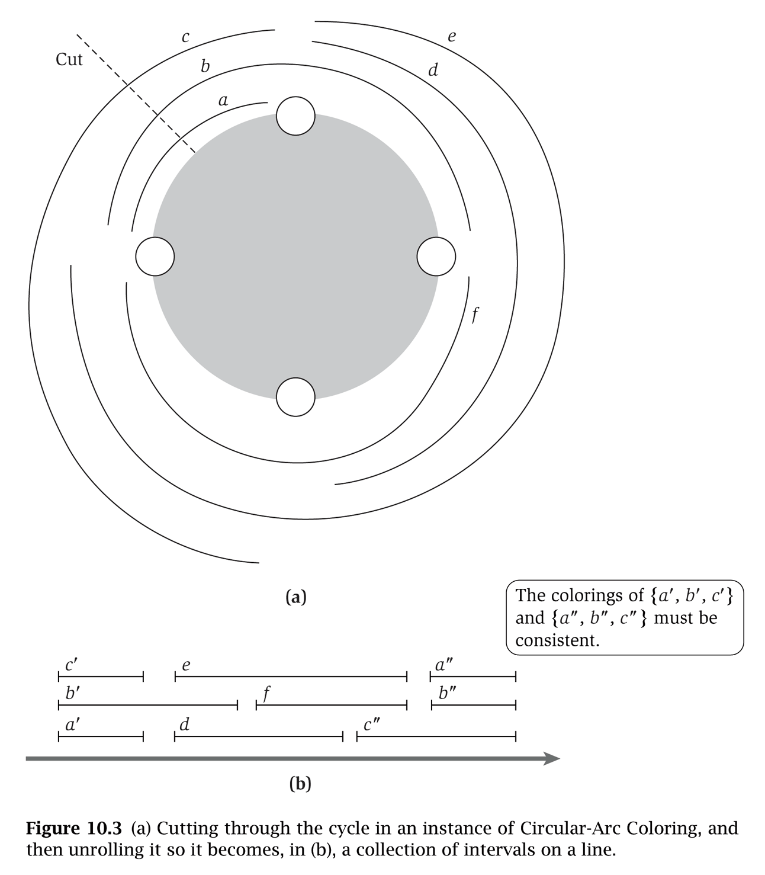
(Almost) Transforming Circular Arc Coloring to Interval Coloring
Circular arc coloring. Given a set of n arcs with depth d ≤ k,
can the arcs be colored with k colors?
Equivalent problem. Cut the network between nodes v₁ and v_{n}. The arcs can be colored with k colors iff the intervals can be colored with k colors in such a way that "sliced" arcs have the same color.
v₁
colors of a', b', and c' must correspond
to colors of a", b", and c"
v₀
v₄
v₂
v₃
v₀
v₁
v₂
v₃
v₄
v₀

Slide 20
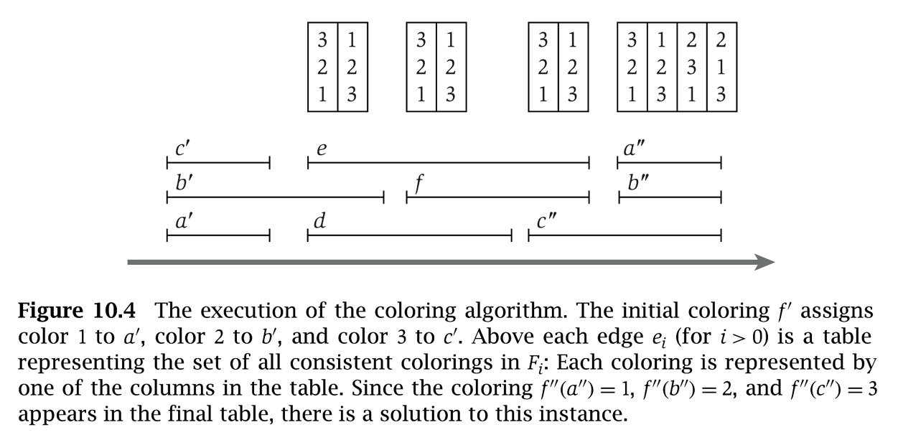
Circular Arc Coloring: Dynamic Programming Algorithm
Dynamic programming algorithm.
  Assign distinct color to each interval which begins at cut node v₀.
  At each node v_{i}, some intervals may finish, and others may begin.
  Enumerate all k-colorings of the intervals through v_{i} that are consistent with the colorings of the intervals through v_{i-1}.
  The arcs are k-colorable iff some coloring of intervals ending at cut node v₀ is consistent with original coloring of the same intervals.
yes
c'
3
e
3
1
e
3
1
e
3
1
a"
3
2
1
2
b'
2
b'
2
2
f
2
2
f
2
2
b"
2
3
2
1
a'
1
d
1
3
d
1
3
c"
1
3
c"
1
1
3
3
v₀
v₁
v₂
v₃
v₄
v₀

Slide 21
Circular Arc Coloring: Running Time
Running time. O(k! ⋅ n).
  n phases of the algorithm.
  Bottleneck in each phase is enumerating all consistent colorings.
  There are at most k intervals through v_{i}, so there are at most k! colorings to consider.
Remark. This algorithm is practical for small values of k (say k = 10) even if the number of nodes n (or paths) is large.

Slide 22
Extra Slides

Slide 23
Vertex Cover in Bipartite Graphs

Slide 24
Vertex Cover
Vertex cover. Given an undirected graph G = (V, E), a vertex cover is a subset of vertices S ⊆ V such that for each edge (u, v) ∈ E, either
u ∈ S or v ∈ S or both.
1
1'
2
2'
S = { 3, 4, 5, 1', 2' }
|S| = 5
3
3'
4
4'
5
5'

Slide 25
Vertex Cover
Weak duality. Let M be a matching, and let S be a vertex cover.
Then, |M| ≤ |S|.
Pf. Each vertex can cover at most one edge in any matching.
1
1'
2
2'
M = 1-2', 3-1', 4-5'
|M| = 3
3
3'
4
4'
5
5'

Slide 26
Vertex Cover: König-Egerváry Theorem
König-Egerváry Theorem. In a bipartite graph, the max cardinality of a matching is equal to the min cardinality of a vertex cover.
1
1'
S* = { 3, 1', 2', 5'}
|S*| = 4
2
2'
M* = 1-1', 2-2', 3-3', 5-5'
|M*| = 4
3
3'
4
4'
5
5'

Slide 27
Vertex Cover: Proof of König-Egerváry Theorem
König-Egerváry Theorem. In a bipartite graph, the max cardinality of a matching is equal to the min cardinality of a vertex cover.
  Suffices to find matching M and cover S such that |M| = |S|.
  Formulate max flow problem as for bipartite matching.
  Let M be max cardinality matching and let (A, B) be min cut.
1
∞
1'
1
2
2'
1
s
3
3'
t
4
4'
5
5'

Slide 28
Vertex Cover: Proof of König-Egerváry Theorem
König-Egerváry Theorem. In a bipartite graph, the max cardinality of a matching is equal to the min cardinality of a vertex cover.
  Suffices to find matching M and cover S such that |M| = |S|.
  Formulate max flow problem as for bipartite matching.
  Let M be max cardinality matching and let (A, B) be min cut.
  Define L_{A} = L ∩ A, L_{B} = L ∩ B, R_{A} = R ∩ A, R_{B} = R ∩ B.
  Claim 1. S = L_{B} ∪ R_{A} is a vertex cover.
    consider (u, v) ∈ E
    u ∈ L_{A}, v ∈ R_{B} impossible since infinite capacity
    thus, either u ∈ L_{B} or v ∈ R_{A} or both
  Claim 2. |S| = |M|.
    max-flow min-cut theorem ⇒ |M| = cap(A, B)
    only edges of form (s, u) or (v, t) contribute to cap(A, B)
    |M| = cap(A, B) = |L_{B}| + |R_{A}| = |S|. ▪

Slide 29
Register Allocation

Slide 30
Register Allocation
Register. One of k of high-speed memory locations in computer's CPU.
Register allocator. Part of an optimizing compiler that controls which variables are saved in the registers as compiled program executes.
Interference graph. Nodes are "live ranges." Edge u-v if there exists an operation where both u and v are "live" at the same time.
Observation. [Chaitin, 1982] Can solve register allocation problem iff interference graph is k-colorable.
Spilling. If graph is not k-colorable (or we can't find a k-coloring), we "spill" certain variables to main memory and swap back as needed.
say 32
variables or temporaries
typically infrequently used
variables that are not in inner loops
Notes:
live range = value of a variable from definition to last usage

Slide 31
A Useful Property
Remark. Register allocation problem is NP-hard.
Key fact. If a node v in graph G has fewer than k neighbors,
G is k-colorable iff G − { v } is k-colorable.
Pf. Delete node v from G and color G − { v }.
  If G − { v } is not k-colorable, then neither is G.
  If G − { v } is k-colorable, then there is at least one remaining color left for v. ▪
delete v and all incident edges
v
k = 3
k = 2
G is 2-colorable even though
all nodes have degree 2

Slide 32
Chaitin's Algorithm
Vertex-Color(G, k) {
while (G is not empty) {
Pick a node v with fewer than k neighbors
Push v on stack
Delete v and all its incident edges
}
while (stack is not empty) {
Pop next node v from the stack
Assign v a color different from its neighboring
nodes which have already been colored
}
}
say, node with fewest neighbors

Slide 33
Chaitin's Algorithm
Theorem. [Kempe 1879, Chaitin 1982] Chaitin's algorithm produces a
k-coloring of any graph with max degree k-1.
Pf. Follows from key fact since each node has fewer than k neighbors.
Remark. If algorithm never encounters a graph where all nodes have degree ≥ k, then it produces a k-coloring.
Practice. Chaitin's algorithm (and variants) are extremely effective and widely used in real compilers for register allocation.
algorithm succeeds in k-coloring
many graphs with max degree ≥ k

